Slide 1
Trello API Automation
Team Xpendables

Slide 2


Introduction
In this presentation, we will explore the implementation of API testing using the Rest Assured framework.
Our goal is to demonstrate the benefits of automating API testing and how it can enhance the efficiency, reliability, and coverage of our testing process.

Slide 3
Agenda
Overview of API Testing
Services
Prioritization and Development
Tool Selection

Slide 4
API Testing Overview

Slide 5

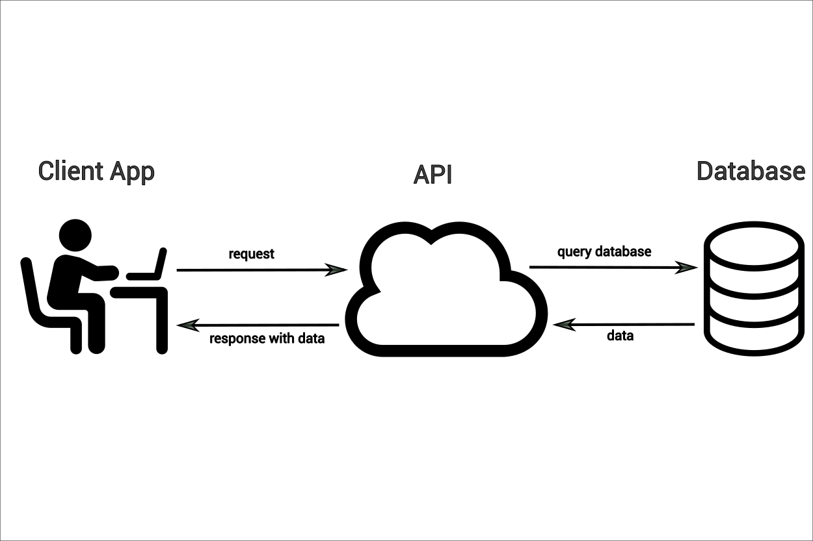
API Testing
API testing is a critical aspect of modern software development that ensures the reliability, security, and performance of the software. By automating API testing, we can achieve faster feedback, better coverage, and higher quality in our applications.
API testing can be further enhanced through automation, which allows for faster, more consistent, and more comprehensive testing, ultimately leading to higher software quality and efficiency.

Slide 6
What to Expect?
Benefits
Responsibilities
Executed much faster, allowing for quicker feedback and shorter development cycles
reducing the risk of human error and ensuring consistent results
Integrating automated tests into the CI/CD pipeline helps catch defects early
enables extensive test coverage
Saving Time, Effort & Cost
Ensure that all aspects of the API are covered
Continuously update and maintain to match changes in the API
Integrate automated API testing into (CI/CD) pipeline

Slide 7
Services

Slide 8
RoadMap
Identify Key Services
Illustrate Endpoints and Methods
Create Test Service
Prioritize Test Service
Develop Test Cases
1
2
3
4
5

Slide 9
Prioritization & Development

Slide 10
Prioritization
Endpoint | Critical Functionality | User Experience | Frequency of Use | Business Impact | Total / 5
Boards | 10 | 7 | 3 | 8 | 7
Cards | 10 | 9 | 10 | 7 | 9
Lists | 10 | 5 | 3 | 6 | 6
Negative | 2 | 3 | 8 | 5 | 4.5

Slide 11
Tool Selection

Slide 12

REST-Assured
Rest Assured is a popular Java library for API automation testing, providing a domain-specific language (DSL) for writing tests.
Why REST-Assured?
Rest Assured is chosen for this project due to its simplicity and efficiency in testing RESTful APIs.
As a Java-based library, Rest Assured provides a fluent and expressive syntax for creating, sending, and validating HTTP requests and responses.
Seamless integration with testing frameworks like TestNG makes it an ideal choice for automating API tests.
Built-in support for JSON and XML parsing, authentication mechanisms, and extensive assertion capabilities, Rest Assured enables comprehensive testing of Trello's API endpoints with minimal setup and coding effort.

Slide 13
Summary
Implementing API testing automation with tools like Rest Assured enhances software development by ensuring quality, reliability, and efficiency throughout the development lifecycle. By prioritizing comprehensive testing services and selecting the right tools, teams can achieve faster releases and improved software performance.

Slide 14
Thank you
Any Questions?

